Slide 1
StorSimple Volume Integrity Checker

Slide 2
High-level workflow of Integrity Check
StorSimpleVolume-AssetsInput
Validate Mandatory Inputs
Fetch existing asset list
Create / Update asset
StorSimpleVolume-DiskIntegrity
Fetch all integrity assets
Verify & Turn on SVA &VM
Fetch VM WinRMUri
Connect VM & Read Initiator name
Fetch all ACR list
Add / Read VMs
ACR data
Read volume list
Turn off
SVA & VM
Initiate Cleanup & Unmount volumes
Send CHKDSK Result (Mail)
Verify CHKDSK execution completed or not
Run CHKDSK on all drives
Connect VM, Mount all volumes & Read Drive letters
Check & Initiate Cloning

Slide 3
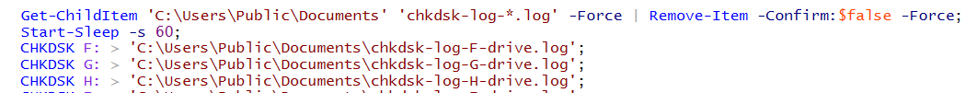
Mount Volumes & Read Drive letters
Before mount the volumes
$initialdisks = (Get-Volume | Where-Object {$_.FileSystem -eq 'NTFS'})
After mount the volumes
$finaldisks = (Get-Volume | Where-Object {$_.FileSystem -eq 'NTFS'})
Filter default drives
$drives = ((Compare-Object $initialdisks $finaldisks -Property 'DriveLetter' | where {$_.SideIndicator -eq "=>"}).DriveLetter | Sort)
CHKDSK Command

Slide 4
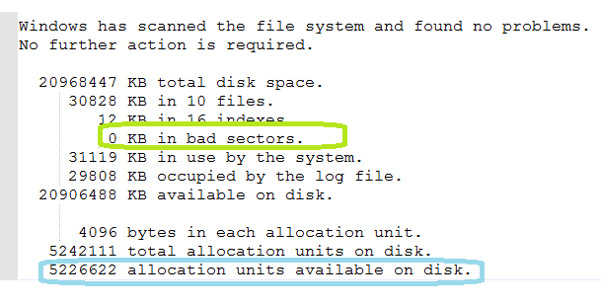
Verify CHKDSK Result
Writing CHKDSK output in log file separately for each drive
Verifying the last write time (Greater than 1 minute) then verify the CHKDSK result
Verify the CHKDSK result
Find Summary tag - allocation units avalable on disk
Find Bad sectors tag - 0 KB in bad sectors
If LastWriteTime greaterthan 2 hours means & No summary info means "Log file created but Summary not found”.
Skipping the drive to check chkdsk summary info → CHKDSK failed
If the log file found bad sectors then skipping the Clean up & Turn off steps. User can login to the VM and cross check the log files for detailed info.
CHKDSK Result

Slide 5
Known Issues
Multi factor authentication must be disabled to execute the runbooks
If a volume doesn't have at least one backup then it'll be skipped to verify data integrity
If a volume already exists in the target device then it'll be skipped from cloning
As per observations, If the runbook takes more than 3 hours, the job itself restarts
Multiple email addresses cannot support in To / Cc address field
Make CHKDSK arguments configurable
Make CHKDSK tool itself configurable

